Slide 1

An investigation of Howard Shore’s use of musical devices in his score for “The Lord of the Rings”
Nathan Guth

Slide 2
Choosing a Topic & Initial Ideas
Music
Film music
Use of film music
The Lord of the Rings
Final Idea:
Howard Shore’s use of musical devices in his score for The Lord of the Rings

Slide 3
Main Objectives
To understand the structure of Howard Shore’s soundtrack
The focus on a few select themes
Identify occurrences of each of these motifs
In the films and in the soundtracks
Investigate the use of musical techniques in the performances of these ideas
Analyse the effect on the film tone & on the audience

Slide 4
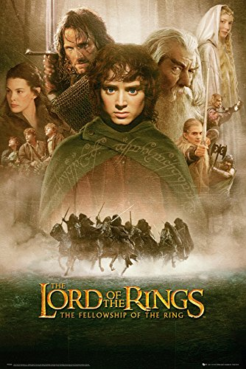
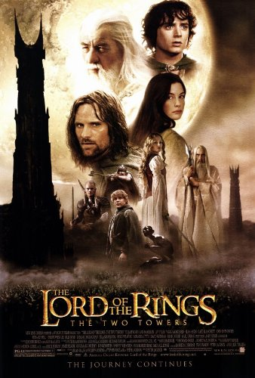
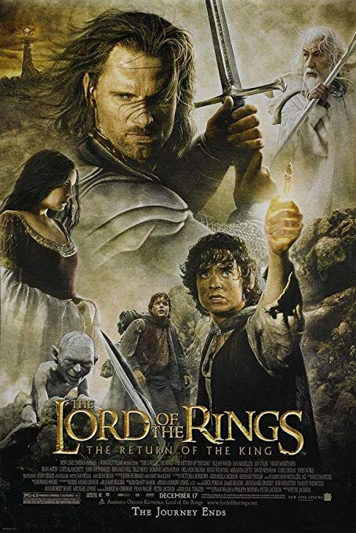
The Lord of the Rings by Peter Jackson
About the trilogy
Some of the biggest and most ambitious film projects ever undertaken
3 films shot simultaneously
Grossing over $870 million
Won 17 out of 30 Academy Award nominations
Return of the King won all 11 of its nominations

Slide 5
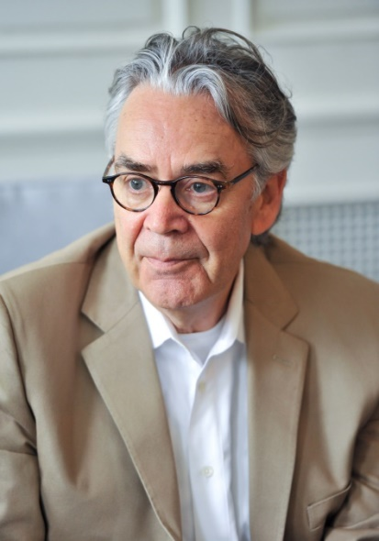
The Lord of the Rings by Howard Shore
About the soundtrack
Features
Over 100 unique and recognizable themes
More than 12 hours of recorded music
More than 15 hours of composed music
Unusual Instrumentation
Featured soloists
Multitude of musical styles
120 players of the London Philharmonic Orchestra
Earned
3 Oscars
2 Golden Globes
3 Grammys
Highly acclaimed & popular

Slide 6
Process
Progression of the project
Start by defining what I was about to research
The Leitmotif

Slide 7
The Leitmotif
Overview
Definition
“A recurring musical theme or idea”
Function and Use
Attach a particular theme/musical idea to a part of the narrative:
Character
Location
Emotion
Event
Object
Notion/Theme
Modify and combine themes over time

Slide 8
Sources & Research
Primary
The Lord of the Rings trilogy
The Lord of the Rings Complete Recordings
“The Music of The Lord of the Rings Films – A comprehensive account of Howard Shore’s Scores” – Doug Adams
Official annotated scores
Interviews and statements by Howard Shore & Doug Adams
Secondary
Huge fandom around Lord of the Rings
Detailed transcriptions of the soundtracks
Various other websites, blogs, articles and academic papers

Slide 9
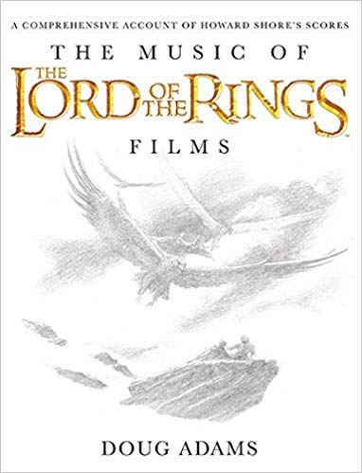
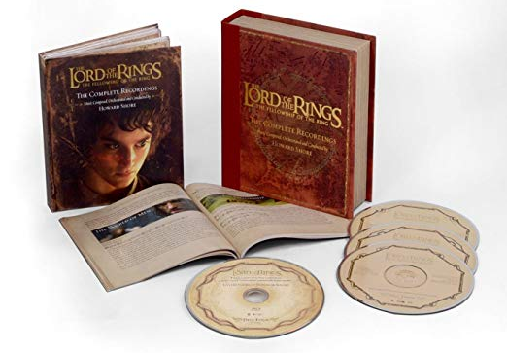
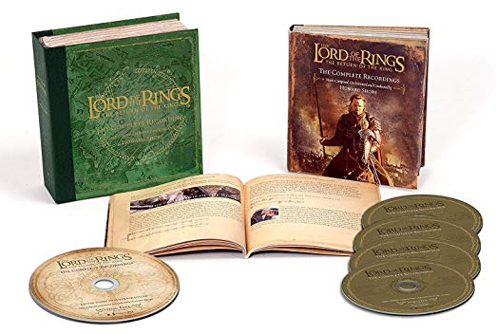
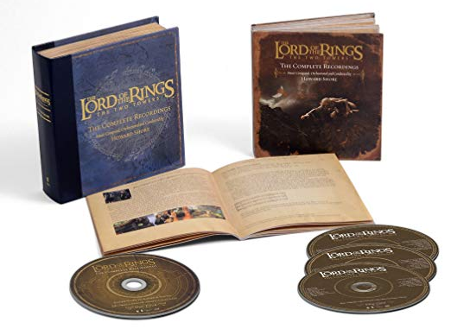
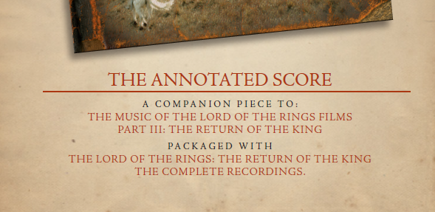
Sources

Slide 10
Structure
Cannot study the whole soundtrack
Chose to focus on 3 motifs
The Shire
A location
The Fellowship
A group of characters
Gondor & Men in Middle-Earth
A location
As well as an idea/ideology
Explore the progression of each themes throughout the narrative

Slide 11
Project Structure
Introduction
About the Lord of the Rings
The Story
Howard Shore’s Score
About the composition process
A Study of leitmotifs
The Leitmotif
Themes
The Shire
The Fellowship
Gondor
Conclusion

Slide 12
Methods
Identify the motif & any sub-motifs
Locate occurrences of motif in soundtrack & films
Transcript the themes
Cut audio of the themes
Interpret any musical decisions by Howard Shore
Merging of themes together
Modifying the themes musically
Tempo
Key signatures
Tonality
Instrumentation
Voices/Soloists

Slide 13
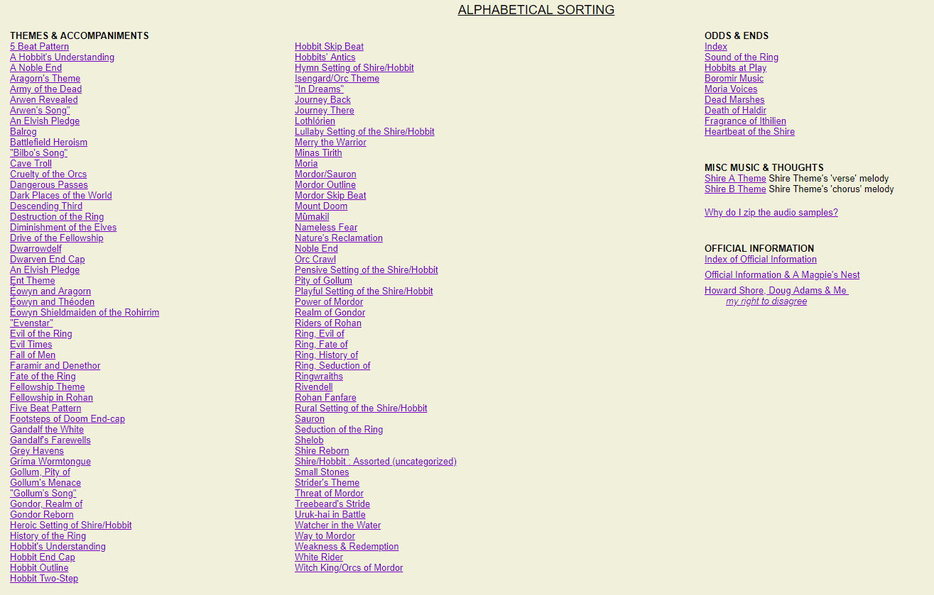
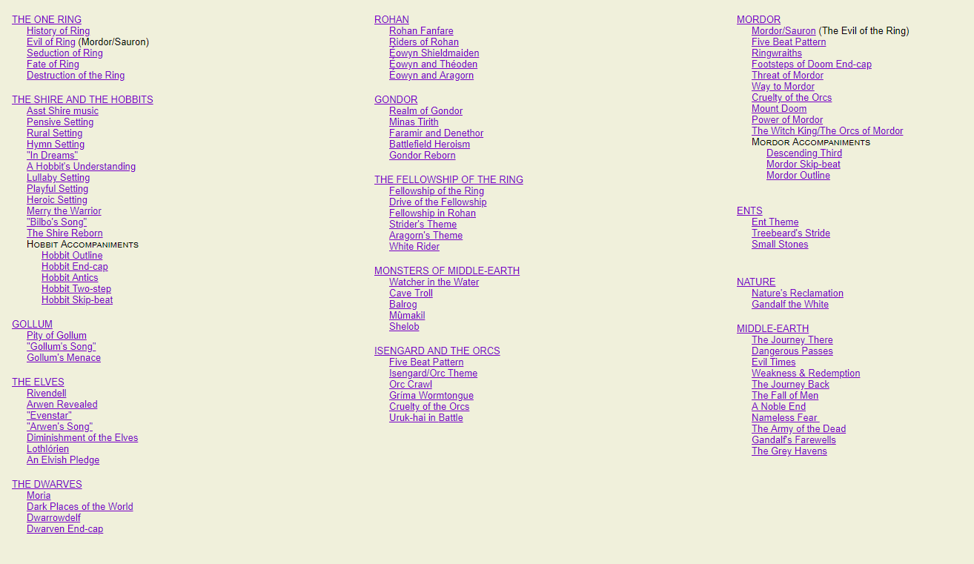
Methods
Identify the motif & any sub-motifs
Over 100 unique themes
Many with sub-themes

Slide 14
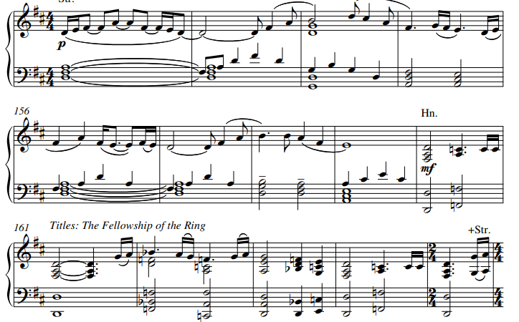
Methods
Transcript the themes
Account for varied instrumentation

Slide 15
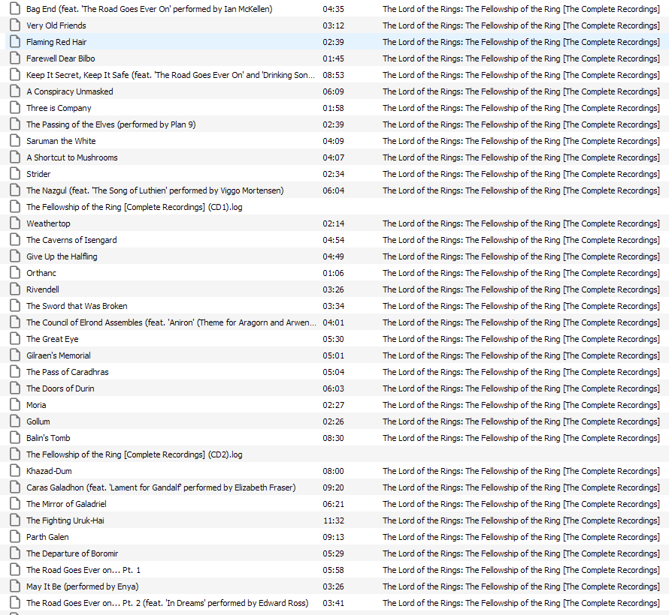
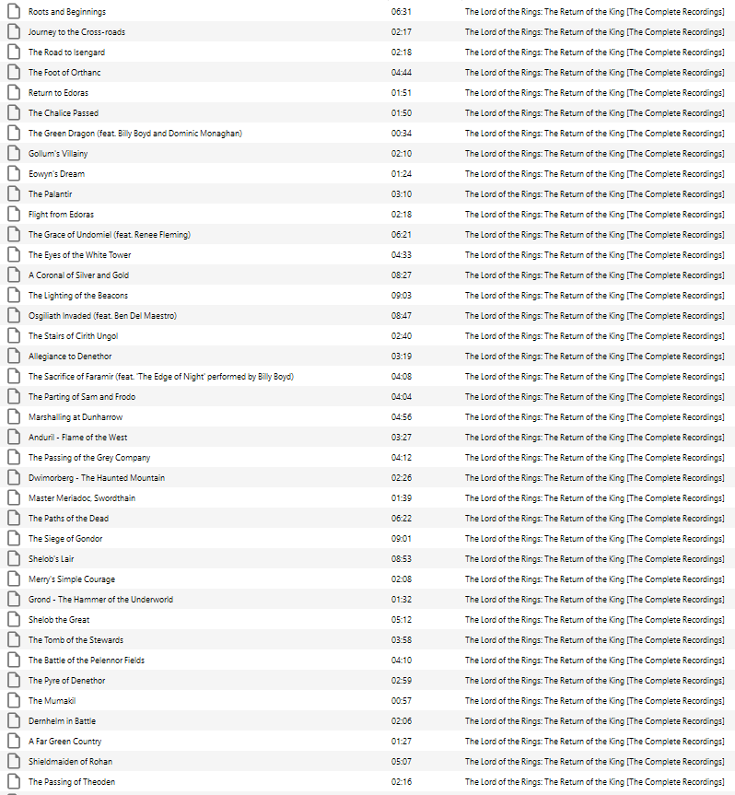
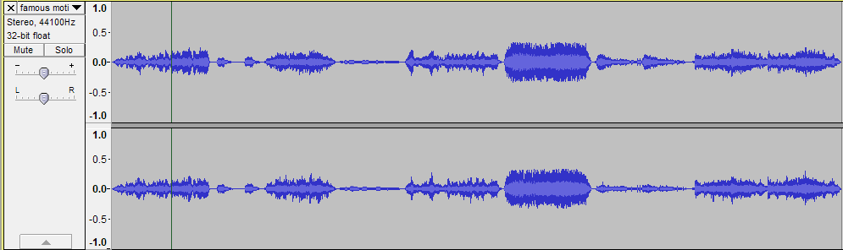
Methods
Cut audio of themes
From 10 hours of audio
135 CD tracks

Slide 16
Evaluation of Project
Strengths
Accessible
No advanced knowledge of the story/music theory needed for understanding
Follows title
A study of leitmotifs, Howard Shore’s score, and musical techniques used
Sources
Uses a collection of primary and secondary resources effectively
Weaknesses
Volume of work to study
The soundtrack is too large for just a few themes to be enough to study it and its effectiveness
Decision making
Especially at the start of the project
Inexperience with writing/structuring research
Time management

Slide 17
Conclusion and Questions
Learning about structuring research
Citations
Bibliography & Filmography
Abstract & Contents
Howard Shore’s work
Unprecedented
Set the bar for film soundtracks high
Has yet to be beaten
Incredibly detailed & complex
Any Questions?

